Slide 1
HIGH
PERFORMANCE
COMPUTING
TIM CARROLL
HPC DEVELOPMENT & STRATEGY
TIM_CARROLL@DELL.COM
Notes:
ASG Complex Solutions – HPC Presentation
This presentation has only been tested on Windows XP running PowerPoint 2003
Developed and maintained by David S. Lee
ASG Complex Solutions Manager – reporting to Tim Carroll (tim_carroll@dell.com)
david_s_lee@dell.com
651-275-9601
If you have any comments or corrections please get in touch with me.
ASG Complex Solutions is on SALESEDGE! Add the ASG Complex Solutions Dashboard to your SALESEGDE Interface
Add the ASG Complex Solutions Dashboard to your Group Pages!
Go to SalesEdge http://salesedge.dell.com/mygroups
Click on Preferences / Under Available Dashboards select ASG Complex Solutions
Click on OK - You now have ASG Complex Solutions Dashboard under My Group Pages tab.
DO NOT DISTRIBUTE THIS PRESENTATION ELECTRONICALLY TO CUSTOMERS VERY CONFIDENTIAL
HOW TO USE:
This presentation MUST be in the same folder as the Enterprise Products Presentation. (EPP)
After linking into the EPP to go back to this presentation hit the ESC key.
The Dell logo on each slide in the lower right corner will link you directly to the beginning of the EPP.
August 2008
This is the first version of this presentation. It works directly with the EPP

Slide 2

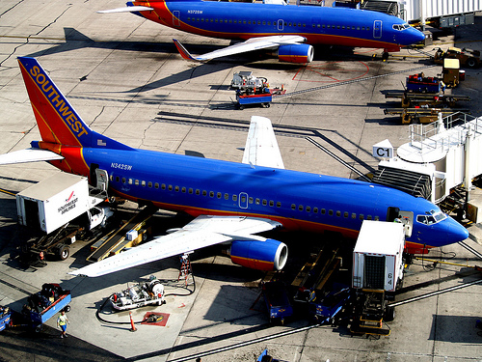
THERE IS MORE THAN ONE WAY TO MEASURE PERFORMANCE
3hour 30min US to Europe
30 minute turn at the gate
Capability or Capacity

Slide 3
THE DELL WAY:
EFFICIENT. OPEN. STANDARD. SIMPLIFIED.
Supply Chain Efficiencies
ODM Enablement
Open & Standard
Blades
IT Simplified
Preemptive Services
Image Direct
Flexible Computing
Cloud Computing
iSCSI Storage
Standards-based
CFI Capabilities
Managed Services
ProSupport
Cost-efficient Model
Product Configurability & Customization
Extend Dell’s Efficiencies to:
Simplify End-to-End Lifecycle Management
Deliver Simplified, Integrated Solutions
Dramatically Change the Services Industry
ASG Tech Summit FY09
3

Slide 4

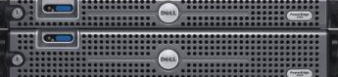
SERVING TODAY’S REQUIREMENTS
We are the cluster workhorse in the research community
High End
  Reliability #1
  Innovation test beds
Volume clusters
  Windows
  Linux
We are investing with research and vendor partners seeking true collaboration
  TACC
  DellXL
  The Mathworks
  Fed

Slide 5
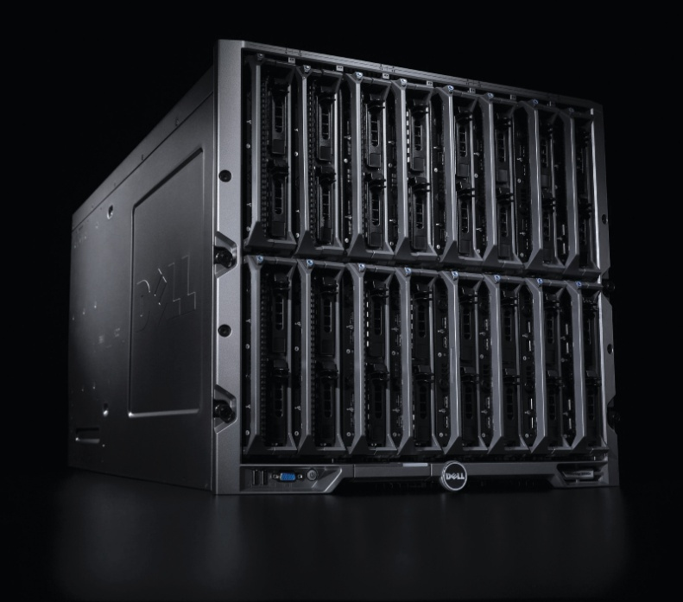
BREADTH BEYOND TECHNOLOGY
Provide a better alternative to 300 watt screen savers
Research Platforms vs. Dedicated clusters
  Visualization
  Web services
  Database
Collaborate with vendor partners to solve non-technical problems
  Licensing models
  Utility computing for overflow and “non-critical” cycles

Slide 6
HIGH
PERFORMANCE
COMPUTING
Notes:
ASG Complex Solutions – HPC Presentation
This presentation has only been tested on Windows XP running PowerPoint 2003
Developed and maintained by David S. Lee
ASG Complex Solutions Manager – reporting to Tim Carroll (tim_carroll@dell.com)
david_s_lee@dell.com
651-275-9601
If you have any comments or corrections please get in touch with me.
ASG Complex Solutions is on SALESEDGE! Add the ASG Complex Solutions Dashboard to your SALESEGDE Interface
Add the ASG Complex Solutions Dashboard to your Group Pages!
Go to SalesEdge http://salesedge.dell.com/mygroups
Click on Preferences / Under Available Dashboards select ASG Complex Solutions
Click on OK - You now have ASG Complex Solutions Dashboard under My Group Pages tab.
DO NOT DISTRIBUTE THIS PRESENTATION ELECTRONICALLY TO CUSTOMERS VERY CONFIDENTIAL
HOW TO USE:
This presentation MUST be in the same folder as the Enterprise Products Presentation. (EPP)
After linking into the EPP to go back to this presentation hit the ESC key.
The Dell logo on each slide in the lower right corner will link you directly to the beginning of the EPP.
August 2008
This is the first version of this presentation. It works directly with the EPP

